Slide 1
Slide Deck 9: Analyzing Election Results

Slide 2
Why is it important to review the results of the provincial election and Student Vote?

Slide 3
The outcome of the election impacts the future direction of the province and the government.

Slide 4
Election Results
After the close of voting on General Voting Day, election officials count the ballots for their voting place and share them with Elections BC, who shares the results publicly.
Results are released on an ongoing basis throughout election night and sometimes the following day.

Slide 5
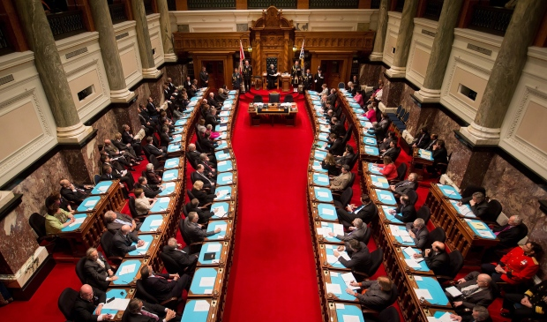
Seat Count
Seat count is the term used to reflect the number of representatives that each party will have in the legislature.
It represents the number of local electoral district races won by each party.
The 87 seats contested in this election are awarded to the candidate in each of the electoral districts who receives the greatest number of votes.

Slide 6
How does a party form government?
The political party with the highest seat count (the party that wins the most seats) usually forms government or becomes the governing party.
The party that receives the most total votes is said to have won the popular vote.
While this is a reflection of support across a jurisdiction, it has no impact on how seats are assigned.
The leader of the governing party becomes the premier.

Slide 7
Will the results of the election result in a minority or majority government?
How do you know?

Slide 8
Majority vs. Minority Governments
A minority government is a government in which the governing party has the most seats compared to any other party, but fewer than half the total number of seats.
A majority government is a government in which the governing party has an absolute majority of the seats (more than half).
In British Columbia, a political party must win 44 seats or more to win a majority government.

Slide 9
Review the results of the provincial election:
Which party won the most seats?
Which party won the popular vote?
Who was elected MLA for your electoral district?
Review the results of the Student Vote:
Which party won the most seats?
Who was elected in your electoral district?
Who was elected by your school?
Notes:
9

Slide 10
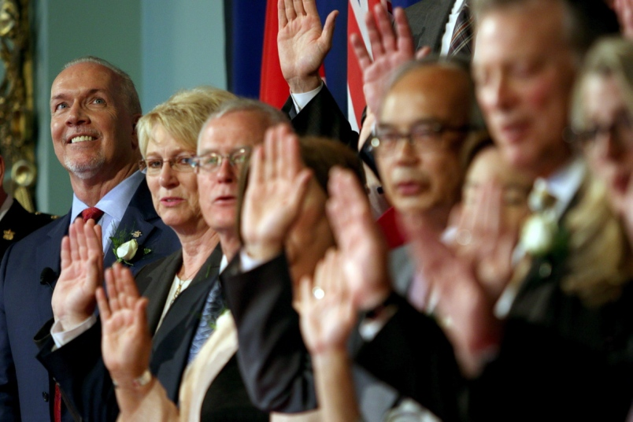
Selecting the Cabinet
The cabinet (also known as the government caucus) is made up of the ministers of government departments.
After the election, the premier selects cabinet ministers from the governing party’s elected MLAs.
Cabinet ministers introduce and debate bills. They also administer specific government departments and formulate government policy, and advise the premier in their area of expertise as a department leader.

Slide 11
The Official Opposition
The political party that receives the second-highest number of seats usually takes on the role of the official opposition.
It is their responsibility to hold the government accountable and to question its actions.
The official opposition organizes a shadow cabinet to act as expert critics on the portfolios or government departments managed by each cabinet minister.

Slide 12
Which party will form the official opposition?
What can an opposition MLA do to be effective in holding the government accountable?

Slide 13
Passing Legislation
In order to pass any legislation (laws) or budgets, the bills must have support from more than half of the members of the Legislative Assembly.
If the governing party has a minority government, they will need to gain the support of the opposition parties or independent candidates in order to pass any legislation.

Slide 14
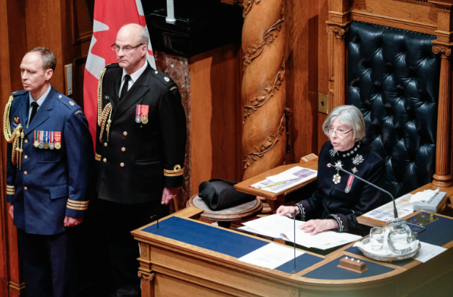
The Throne Speech
The speech from the throne (also known as the throne speech) outlines the government’s plans and initiatives.
The speech is delivered by the lieutenant governor at the beginning of each new session of the legislative assembly.

Slide 15
Debrief
What was your reaction to the election results?
What do you think that the priorities of the new B.C. government will be?
In what ways can you remain involved in politics between elections?

