Slide 1
Visual Timeline
English and French Canadian Relations

Slide 2
Treaty of Paris (1763)
Conscription Crisis WWI (1917)
Maurice Duplessis (Union Nationale) (1936-1939 and 1944-1959)
Conscription Crisis WWII (1942)
New Canadian Flag (1965)
Speech at Expo 67 (1967)
Front de Libération du Québec (1960s and 1970s)
Bilingualism and Biculturalism Commission (1963)
Official Languages Act (1969)
October Crisis (1970)
Parti Québécois (1976)
Bill 101 (1977)
Quebec referendum on “Sovereignty-Association” (1980)
Constitution Act (1982)
Meech Lake Accord (1990)
Bloc Quebecois (1990)
Charlottetown Accord (1992)
Quebec Sovereignty Referendum (1995)
Clarity Act (1999)
Quebec Act (1774)

Slide 3
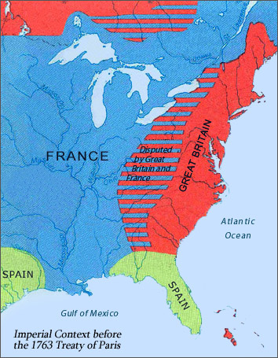
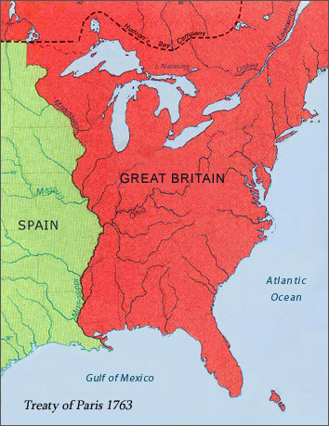
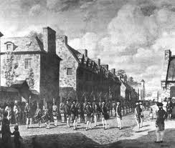
1763 – Treaty of Paris
Promised to protect French language and culture in order to keep the French from leaving. France to give up New France; felt betrayed.

Slide 4
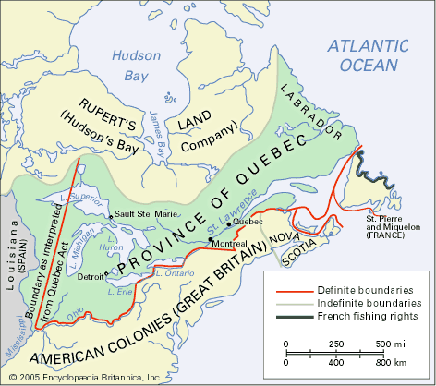
1774 – The Québec Act
Canada’s first constitution.
Entrenched the rights of French Canadians
Religious freedom was guaranteed for the colony's Roman Catholic majority.
The Act restored French civil law and British criminal law and provided for continued use of the seigneurial system.

Slide 5
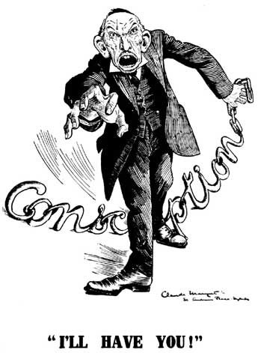
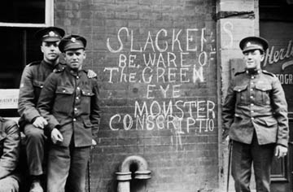
1917 – Conscription Crisis of World War One
French Canadians felt they were being forced to fight a war with no connection to them which strained their relationship with the more willing English Canadians

Slide 6
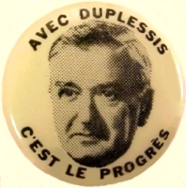
1936-1939 and 1944-1959 – Maurice Duplessis (Union Nationale)
He lead the Duplessis Era which encouraged French Canadians to think of Québec as a special society or Nation rather than just another province

Slide 7
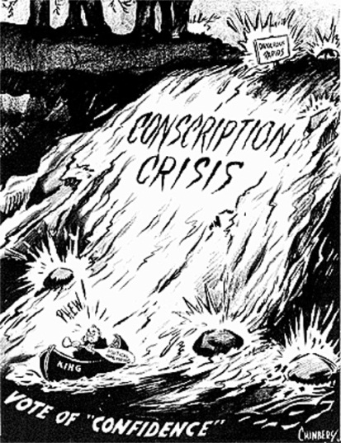
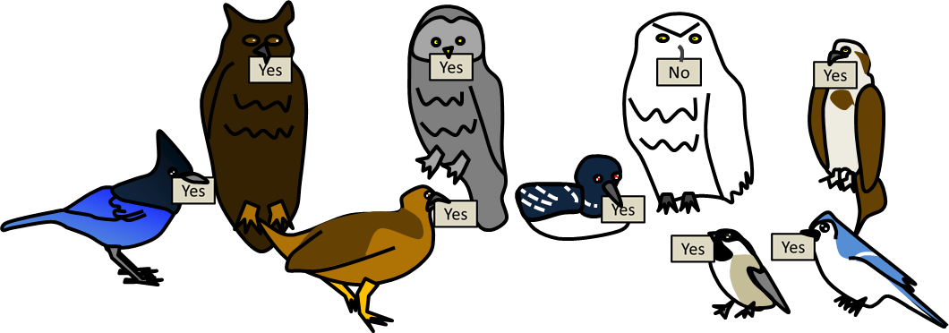
Conscription Crisis of World War Two (1942)
The plebiscite on conscription alienated Québec, literally splitting them from the English speaking Canadians

Slide 8
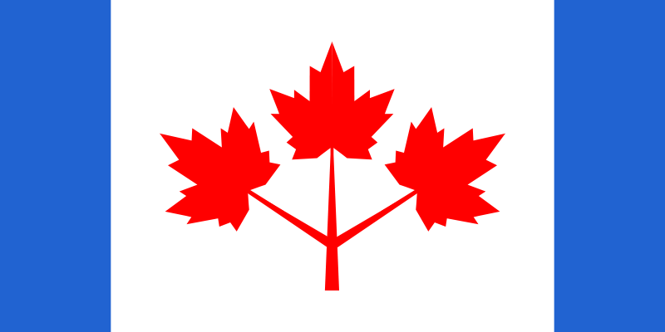
1965 – New Flag Adopted in order to make Canada less British
The bitter debate split the country between French and English Canadians and left neither satisfied

Slide 9
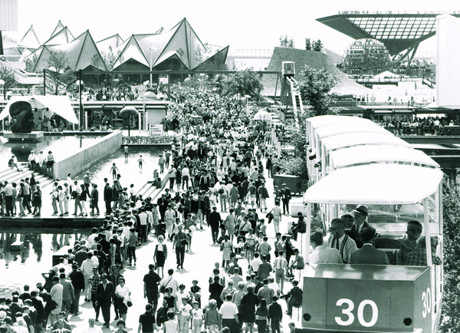
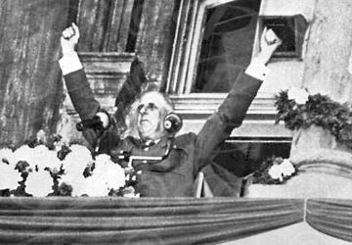
Separatist Movement – De Gaulle’s Speech at the 1967 Expo
Enraged English Canadians and encouraged French Canadians to have separatist feelings

Slide 10
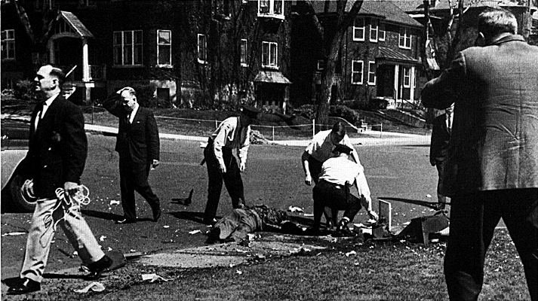
1960s and 1970s – Front de Libération du Québec (FLQ)
French separatist who activity fought against and harmed English Canadians, showing both sides they were willing to fight for a free Québec

Slide 11
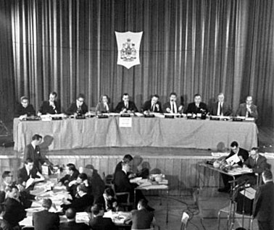
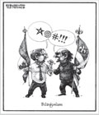
1963 – Lester Pearson Appointed the Bilingualism and Biculturalism Commission
Meant to make French Canadians feel more at home, but was ignored until Trudeau came into power

Slide 12
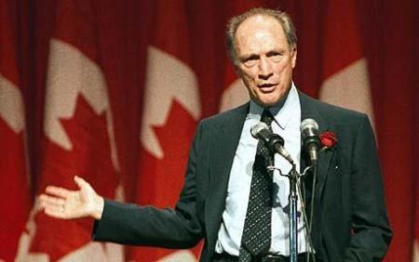
1969 – Trudeau’s Government Passed Official Languages Act
While some Canadians embraced bilingualism, Anglophones in Western Canada was furious and Francophones in Quebec felt that not enough had been done

Slide 13
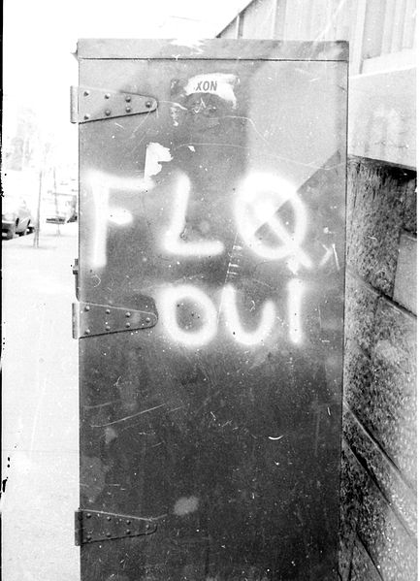
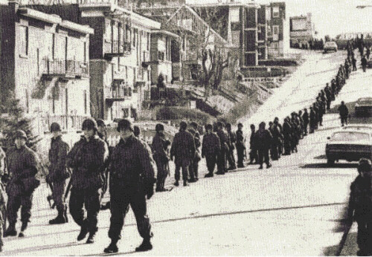
1970 – October Crisis
Showed how far separatist (FLQ) were willing to go as well as how much the government was willing to stop them
(Increased separatist feelings in French Canadians)

Slide 14
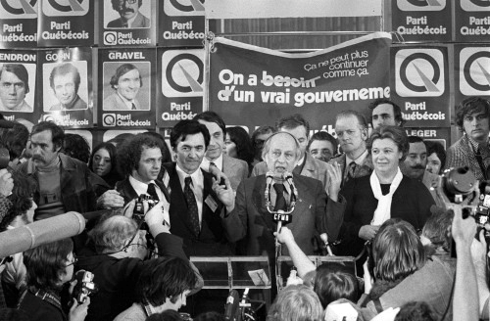
1976 – Parti Québécois
A separatist provincial party that made big changes in order to protect French language and culture and to strive for an independent Québec

Slide 15
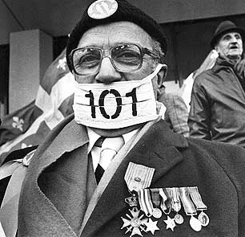
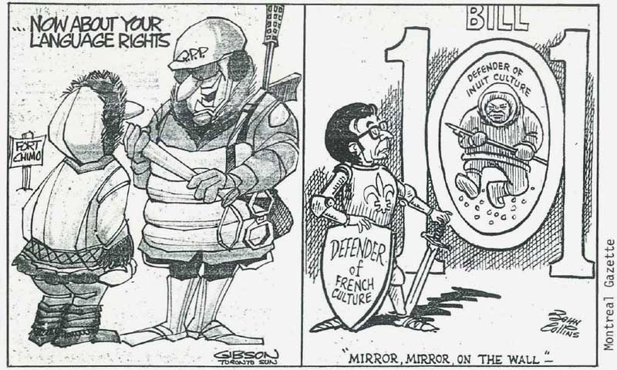
1977 – Passage of Bill 101
Made the French Canadians feel secure, but enraged English Canadians (especially those living in Québec)

Slide 16
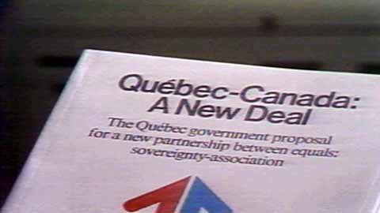
1980 – Quebec referendum on “Sovereignty-Association”
Showed that 40% of Quebecois wanted Sovereignty by association (Independent Country, but closely bonded to Canada)

Slide 17
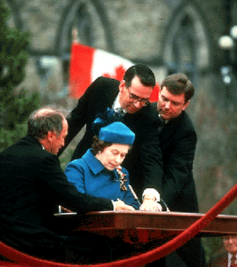
1982 – Constitution Act
Meant to make the Quebecois more comfortable, but they were the only ones not to sign it (done without their permission) which alienated Québec

Slide 18
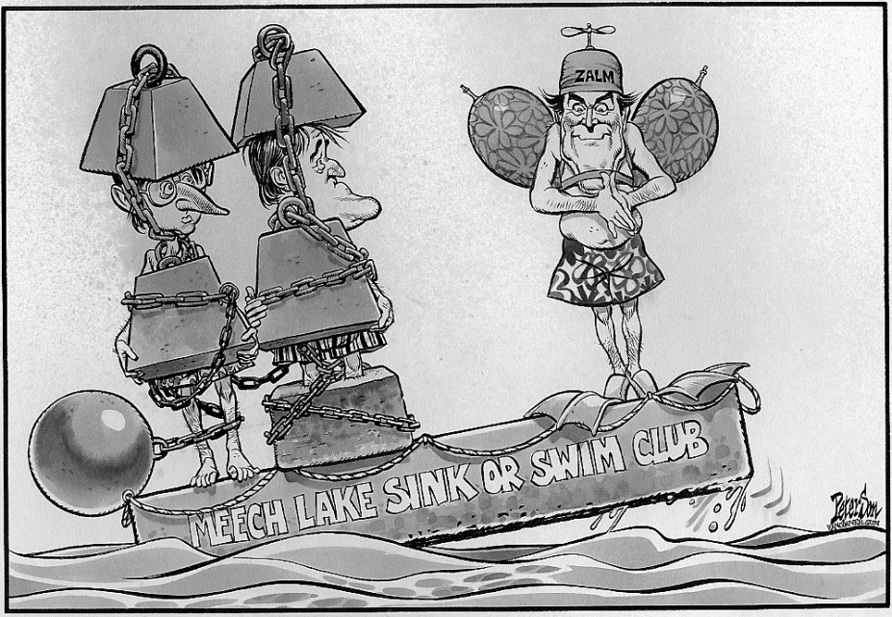
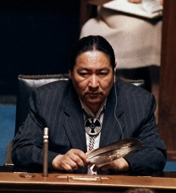
1990 – Meech Lake Accord
Meant to satisfy Québec by making them a distinct society, but was rejected and ended up humiliating them instead

Slide 19
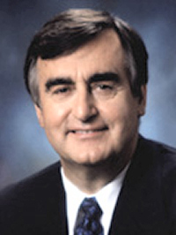
1990 – Creation of Bloc Quebecois by Lucien Bouchard (Federal Separatist party)
Made in response to the rising support for Québec separation and in protest of the humiliation at the Meech Lake Accord

Slide 20
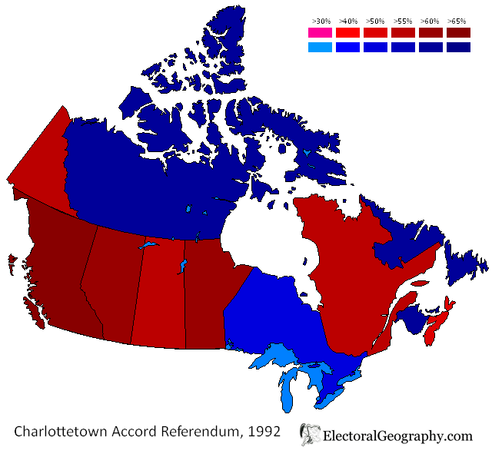
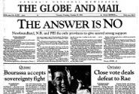
1992 – Charlottetown Accord
Once again tried to appease Québec, and once again it failed, angering Quebecois

Slide 21
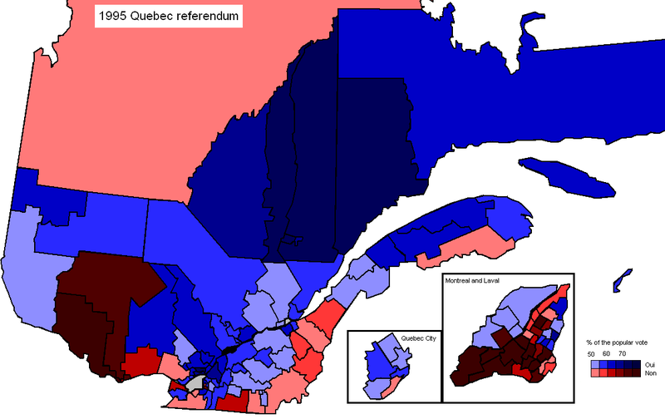
1995 – Quebec Sovereignty Referendum
Showed that 49.4% of Quebecois wanted full sovereignty, frightening the English Canadians

Slide 22
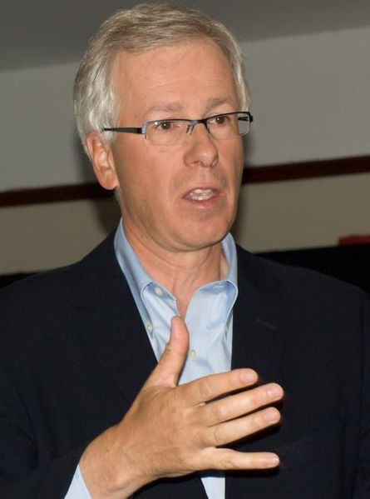
1999 – Clarity Act
Guaranteed Québec could not legally separate from Canada whether Quebecois what it to or not

